Slide 1

Metrics for evaluating performance
Notes:
1

Slide 2
Objectives
Understand the Metrics for evaluating performance of forecasting model
Implement the Metrics for evaluating performance of forecasting in Numpy
Metrics for evaluating performance
2

Slide 3
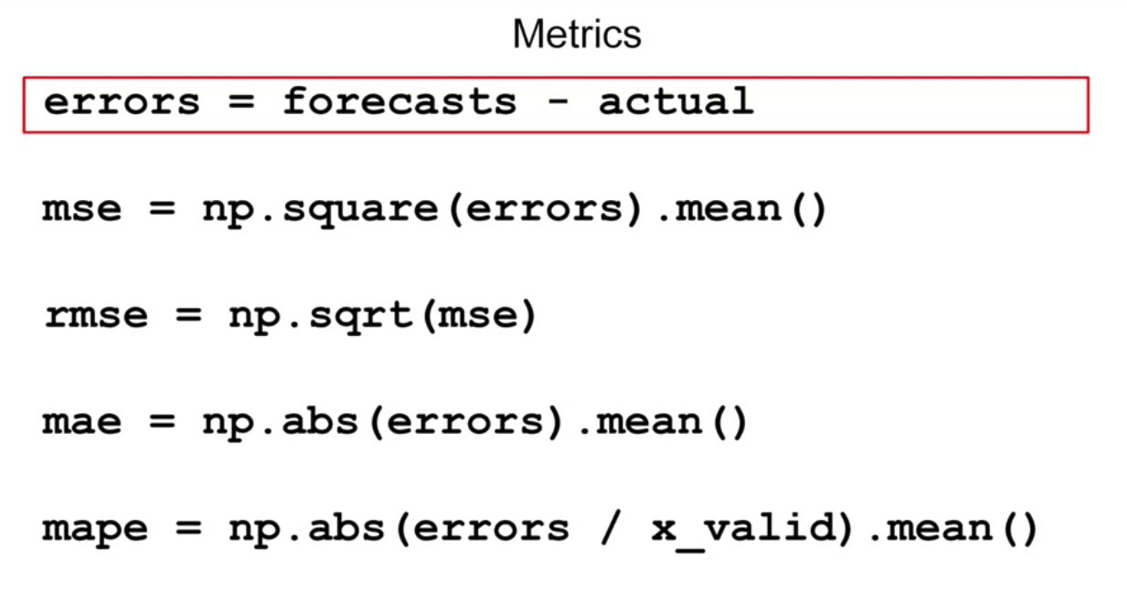
The Errors
The difference between the forecasted values from our model and the actual values over the evaluation period.
Metrics for evaluating performance
3
Notes:
3

Slide 4
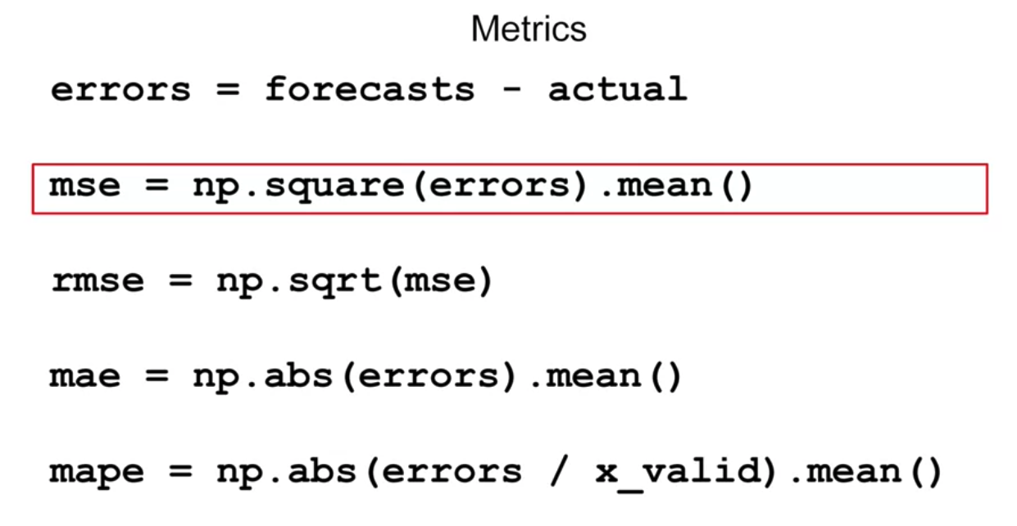
The Mean Squared Error
Square the errors and then calculate their mean. Why would we square it?
Metrics for evaluating performance
4
Notes:
4

Slide 5

The Mean Squared Error
Measures the average squared difference between predicted and actual values.
Formula:
Metrics for evaluating performance
5
Notes:
5

Slide 6
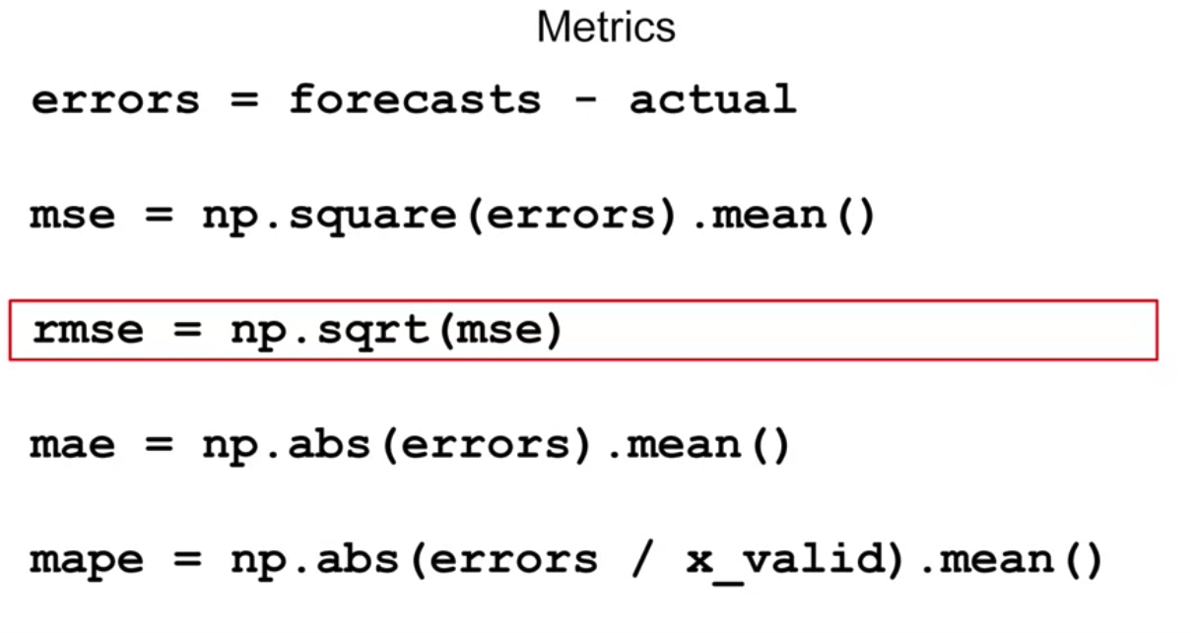
The Root Mean Squared Error
If we want the mean of our errors' calculation to be of the same scale as the original errors, then we just get its square root, giving us a root means squared error or rmse
Metrics for evaluating performance
6
Notes:
6

Slide 7
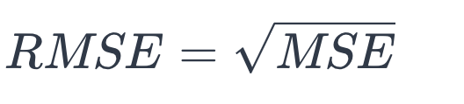
The Root Mean Squared Error
The square root of MSE; provides an interpretable measure in the same units as the target variable.
Formula:
Metrics for evaluating performance
7
Notes:
7

Slide 8
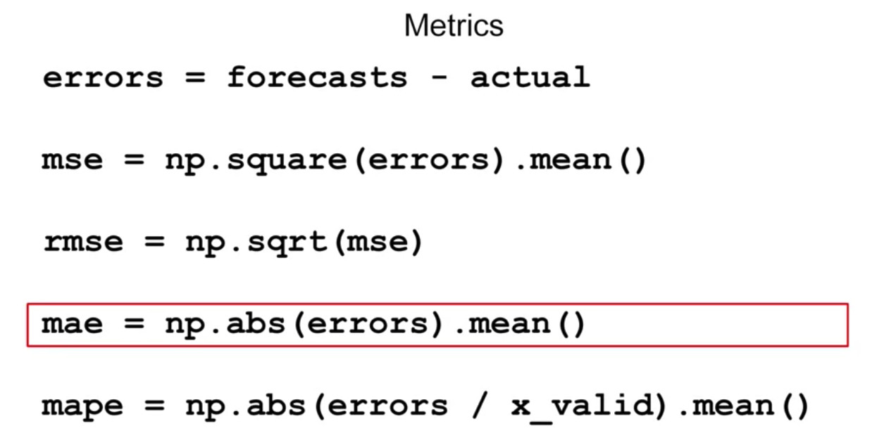
The Mean Absolute Error
Uses their absolute value
Metrics for evaluating performance
8
Notes:
8

Slide 9

The Mean Absolute Error
Measures the average absolute difference between predicted and actual values.
Formula:
Metrics for evaluating performance
9
Notes:
9

Slide 10
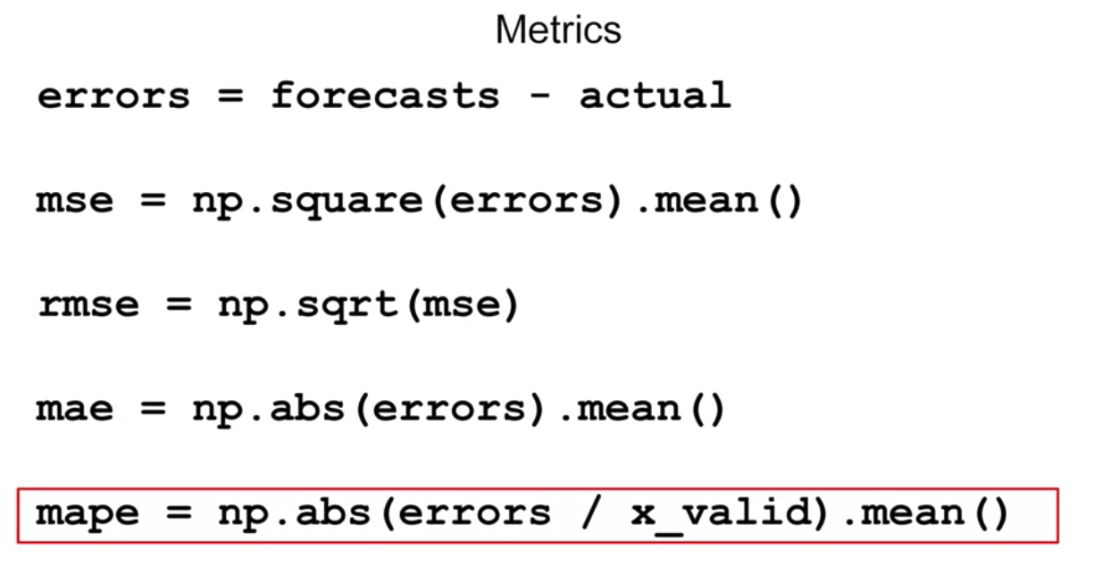
The Mean Absolute Percentage Error
The mean ratio between the absolute error and the absolute value, this gives an idea of the size of the errors compared to the values.
Metrics for evaluating performance
10
Notes:
10

Slide 11
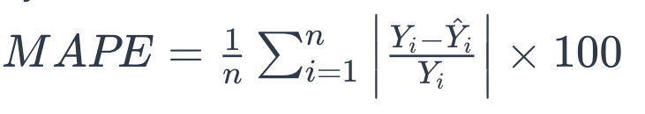
The Mean Absolute Percentage Error
Expresses errors as a percentage of the actual values, providing a relative measure of accuracy.
Formula:
Metrics for evaluating performance
11
Notes:
11

Slide 12
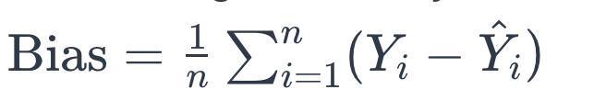
The Forecast Bias
Measures the average tendency of the forecast to be too high or too low.
Formula
Metrics for evaluating performance
12
Notes:
12

Slide 13
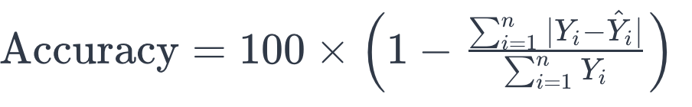
The Percentage Forecast Accuracy
Measures the overall accuracy of the forecast as a percentage.
Formula:
Metrics for evaluating performance
13
Notes:
13

Slide 14
Summary
Understand the Metrics for evaluating performance of forecasting model
Implement the Metrics for evaluating performance of forecasting in Numpy
Metrics for evaluating performance
14

Slide 15
Q & A
Metrics for evaluating performance
15

